Slide 1
PSYC 530: Concepts and Principles of Behavior Analysis
Megan Aclan, PhD, BCBA-D

Slide 2
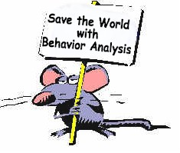
What We Will Cover
“That there could be a science of behavior, of what we do, of who we are? How could you resist that?” -Donald Baer

Slide 3
And Action…
https://www.youtube.com/watch?v=S7qoQS3EiNE
https://www.youtube.com/watch?v=ZbYI1pBDylw
Notes:
What are you gong ot learn?
Basic principles of ABA
ABA research methods a
Using ABA behaivor change procedures

Slide 4
Flashcards
SAFMEDS
“Say All Fast Minute Every Day Shuffled”
Ogden Lindsley
See definition, Say term
See term, Say definition

Slide 5
What you will Do At the end of the semester
Identify textbook definition
Identify novel example
Identify layman’s definition

Slide 6

What I expect from you…
Check Blackboard regularly
Follow class schedule
Be ready for class
Be present
Pack up at the END of class
No cell phones!

Slide 7
What you can expect from me….
Respect
Facilitate your learning
Objective and fair

Slide 8
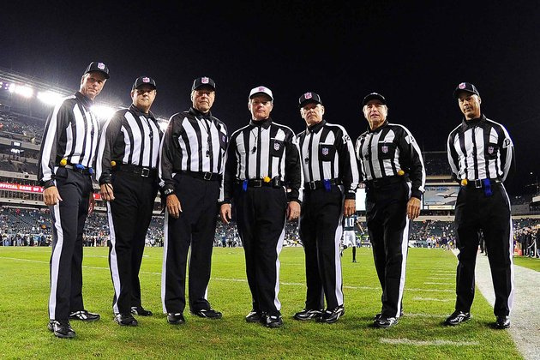
My Role…
Notes:
Coach- facilitate your interest in behavior analysis
Cheerleader- want everyone to do well and learn
Referree- play fair

Slide 9
Be Honest
Maintain academic honesty standards set forth by USC
Cheating, copying, etc. WILL NOT BE TOLERATED
Severe consequences

Slide 10
Tips to Do Well
Do well
Read
Review Notes
Own words
Explain to someone else
Notes:
It’s a cycle!

Slide 11

Questions?

Slide 12
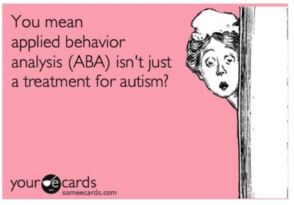
Introduction to Behavior Analysis

Slide 13
Branches of Behavior Analysis
EAB- experimental analysis of behavior
BF Skinner, lab setting
ABA- applied behavior analysis
Behaviorism- the philosophy of the science of behavior
No longer looking at mental processes BUT focusing on OBSERVABLE OBJECTIVE BEHAVIORS
Notes:
1900s- dominated by mental processes (freud)
Behavior- beginning in 1930s with BF skinner

Slide 14
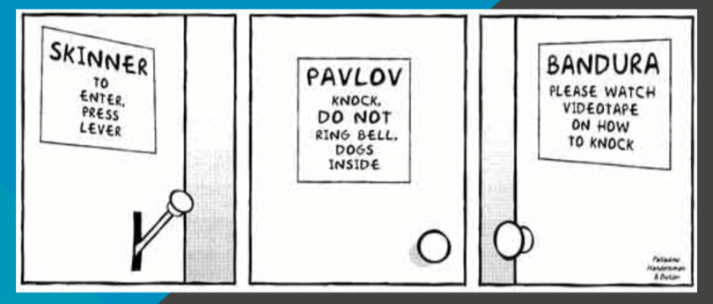
Stimulus- an energy change that effects an organism through its receptors (Cooper et. al, 2007)
Notes:
Pavlov-1927/1960= involunary reflexive beahivors (elicited)
Stimulus- pavllov – bell
Skinner-explaining volunary beahvs (beahviors influended by what has followed the behavior)

Slide 15
Behavior
Dead man’s test
If dead man CAN do it= it is NOT a behavior
If a dead man CAN’T do it= a behavior
Behavior= Response
Movement, action, etc.

Slide 16
Let’s take a closer look…
Before behavior
Behavior/Response
After Behavior

Slide 17
Behavior Analysis
The study of the principles of behavior
Applied Behavior Analysis- using the principles of behavior to solve problems of social significance
Notes:
significance means meaning. That means: If you create meaning for other people, you are significant to them; you are socially significant. Social significance is what makes people confident they can understand you and what you do for or to them.

Slide 18
Where can we use ABA?
Developmental disabilities
Sports
Parenting
Self management
Mental illness
Business and industry
Gerontology

Slide 19
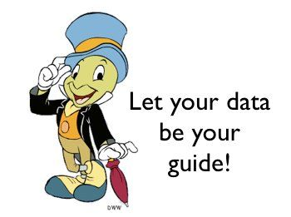
Behavior Interventions
Data based (scientific demonstration)
Technological
Precise methods and rationales
Implemented across environments

Slide 20
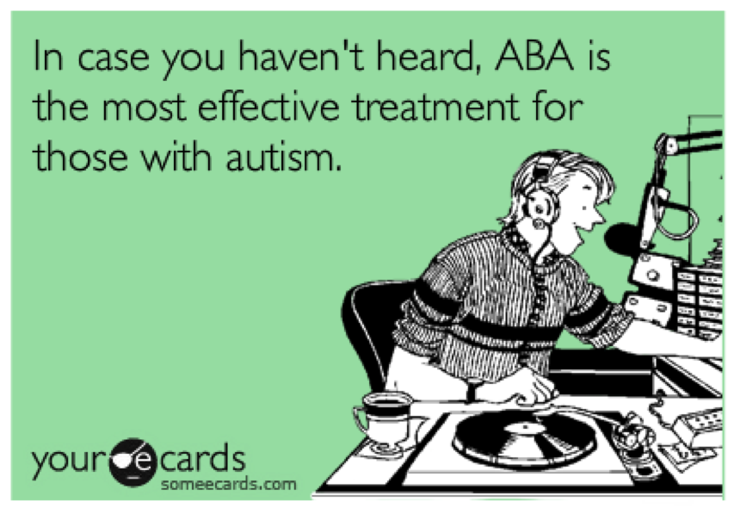
Remember…

